Slide 1
Getting Started
A GUIDE FOR INDIANA EMPLOYMENT SPECIALISTS

Slide 2


Getting Started
A Guide for Indiana Employment Specialists
Produced by:
With funding from:
© Center on Community Living and Careers, May 2020
Getting Started: A Guide for Indiana Employment Specialists was created by the Employment Technical Assistance Team of the Center on Community Living and Careers. Contact them at EmployTA@iu.edu with questions or for information on CCLC benefit and employment trainings.

Slide 3
Table of Contents
  Introduction 4
  Find a Mentor 7
  General Information 10
    Your Go-To References 13
      Supported Employment: Foundations & Philosophy 15
    The Work You’ll Be Doing 18
      Your Go-To VR Forms 19
      2. Discovery 21
      3. Job Readiness 26
      4. Job Development 28
      5. Job Placement Training & Supports 32
      6. Stabilization 37
      7. Extended Services & Ongoing Supports 39
    Training for Indiana Employment Specialists 41

Slide 4

Introduction
Learning a new job does not start and end on your first day. It’s an ongoing process.
This guide is for Indiana employment professionals working with community employment providers around the state. You may be new to this work, or you could be familiar with your role but new to your company. Or both. In any case, this guide will help you get started and acquaint you—or provide you with an update—on how to be successful with your job seekers and within your new company.

Slide 5


Quick note
Some of you may refer to yourselves as employment specialists, while others may use employment consultant to describe your duties. It’s okay. For consistency, we’re going to go with employment specialists, but Getting Started is for all Indiana employment professionals who assist job seekers with disabilities on their journey to getting hired, keeping a job they like, finding a new career, or earning a promotion.

Slide 6

Whatever your title…
…this guide will help you understand your field, reach your full potential, and get started quickly.
We don’t expect you to go it alone. It’s important that you process this information with your supervisor or a mentor in your company. As suggested throughout Getting Started, take time to discuss the materials and resources you’ll find on the following pages.

Slide 7

28
First things first!
Find a mentor.

Slide 8
Here’s what you can expect your mentor to do:
First things first! Before anything else happens, you should have a mentor. Since you may be new to your role and your company, ask your supervisor who this person is—and then meet them as soon as possible.
A mentor acts as a trusted and experienced advisor. Think of your mentor as “a friendly guide in a foreign country.”
Ideally, you, your mentor, and your supervisor will be referencing this guide throughout the first several months.
Share job function knowledge
Explain workplace culture
Teach new skills
Model new skills
Provide feedback
Tell other staff about the new skills you’ve gained
Provide a judgement-free venue for questions and answers
and SO MUCH MORE!
“Mentoring is a brain to pick, an ear to listen, and a push in the right direction.”
— John Crosby

Slide 9


The ‘Getting Started’ overview
In the weeks to come you’ll be learning about your new company, about the job seekers you’ll be working with, and about best practices in your agency and the field.
You’ll also be learning the principles behind supported employment and how best to implement effective services and activities so that job seekers can successfully find career paths and employment that matches their interests and strengths.

Slide 10
Getting Started:
General Information
*

Slide 11
Your agency orientation checklist
Review and discuss your company’s mission statement.
Review and discuss your company’s vision statement.
Review and discuss policy and procedure.
Complete required new-hire paperwork.
Receive and review your job description.

Slide 12
Your agency orientation checklist, continued
6
Obtain an overview of your department.
7
Meet your department staff.
8
Tour your company’s site location(s).
9
Meet non-department agency staff.
10
Meet VR participants (clients of your company) who are using your company’s services.

Slide 13
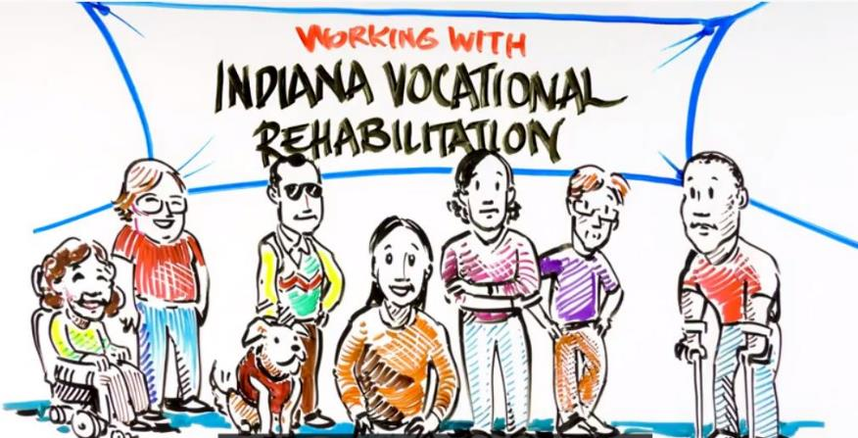
‘Working with
Indiana VR’
Sometimes you may need a quick way to introduce new clients to the process of employment services and supports in Indiana. “Working with Indiana VR,” available in Spanish and English, explains VR’s application and eligibility process. It also describes services available for job seekers, students with a postsecondary education goal, and employees who are looking for a new job or who have a new employment goal.
Preview the videos here:
Working with Indiana VR
Trabajando con Rehabilitacion Vocacional de Indiana

Slide 14
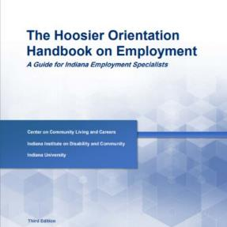
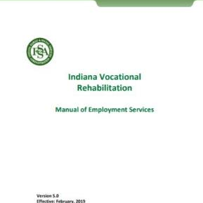
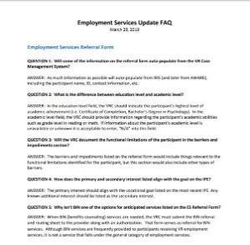
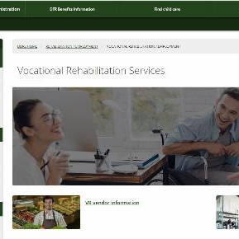
Your go-to references
You will be referencing several documents, repeatedly, throughout the sections that follow. We suggest bookmarking or keeping the following documents and references “open in another tab:”
Hoosier Orientation Handbook on Employment: Guide for Employment Specialists
Indiana VR Manual of Employment Services
VR Employment Services Update FAQs
Indiana VR Webpages

Slide 15

Supported Employment:
Foundations & Philosophy
1

Slide 16





Supported Employment: Your to-do list
Read "Ethical Guidelines for Professionals in Supported Employment." Take notes as you read the guidelines and discuss these notes with your mentor or supervisor.
Read Association of People Supporting Employment First's Universal Employment Competencies. Take notes as you read the competencies and discuss these notes with your mentor or supervisor.
Read the “Foundations of Supported Employment” in the Hoosier Orientation Handbook on Employment (2017). Answer corresponding questions found on pages 15, 22, 26 and 33. Take notes as needed and discuss these notes with your mentor or supervisor.
Read through the following references and materials. They’ll provide you with a good footing and understanding of supported employment, which is really the foundation of the services you’ll be providing to job seekers with disabilities.
Visit “Disability Etiquette Putting People First.”
Read “10 Commandments of Communicating with People with Disabilities.”
Study and review the acronyms found on pages 91-94 in the Hoosier Orientation Handbook on Employment (2017).

Slide 17






Supported Employment
Services:
Your to-do list
Register for employment specialist training in Indiana. (See training recommendations, page 41.)
Read the “Referral and Funding Sources” in the Hoosier Orientation Handbook on Employment (2017) found on pages 36-46. Answer corresponding questions found on page 45. Take notes as needed and discuss these notes with your mentor or supervisor.
Locate and become familiar with the Indiana VR Manual of Employment Services. Take notes and discuss how to effectively work within the VR structure of employment services.
The to-do list on this page provides you with the background you’ll need to begin working with job seekers and collaborating with your area Indiana Vocational Rehabilitation counselors and other staff members.
Study the Employment Services Workflow.
Become familiar with the locations and contact information from Vocational Rehabilitation offices near your agency.
Call or email your area VR counselors and VR case coordinators to introduce yourself.

Slide 18
Getting Started:
The Work You’ll Be Doing
*

Slide 19
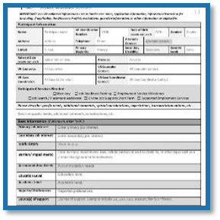
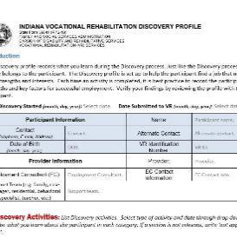
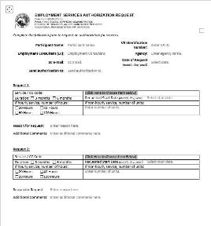
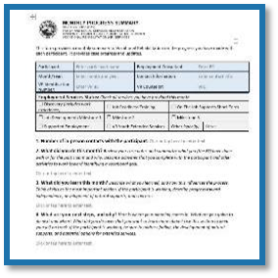
Your go-to VR forms
Become familiar with the forms listed here and on the next page. They’re all available on the
Indiana Vocational Rehabilitation website.
Employment Services Referral
Discovery Profile
Employment Services Authorization Request
Monthly Progress Summary
Continued on the next page.

Slide 20
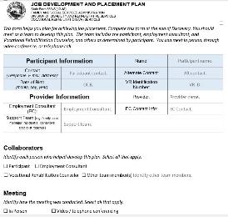

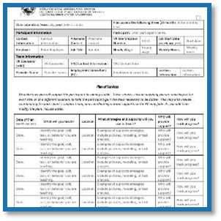
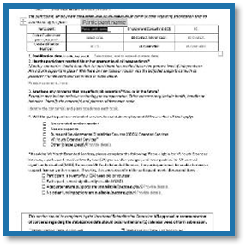
Your go-to VR forms, continued
More VR forms you’ll use on the job. You’ll find these and other forms on the
Indiana Vocational Rehabilitation website.
Job Development and Placement Plan
Notice of Job Offer
Employment Support and Retention
Stabilization

Slide 21

Discovery
2

Slide 22



Discovery:
Your to-do list
Consider registering for Discovery training offered by the Center on Community Living and Careers.
Review the Referral Form and Authorization Request. Pay close attention to diagnosis, other contacts, guardianship, VR service request, authorized hours, and collateral information. Take notes and discuss any questions you have with your mentor or supervisor.
Review the presentation, Trial Work Experiences, on the CCLC website.
Read “Discovery: Getting to Know Your Job Seeker” in the Hoosier Orientation Handbook on Employment on pages 56-59. Answer corresponding questions found on page 59. Take notes and discuss any questions you have with your mentor or supervisor.
Discovery begins with the premise that everyone can work. It’s the foundation of employment and career planning in the state of Indiana.
Both a process and a journey, Discovery is supported by Indiana Vocational Rehabilitation because it helps job seekers identify the types of environments they might like to work in, the tasks they find enjoyable, and the work that gives them satisfaction.
Read the Indiana VR Manual of Employment Services (pages 3-10) to better understand expectations for quality services for Discovery. Take notes and discuss any questions you have with your mentor or supervisor.
Watch this “how-to" video on the Discovery Profile. Take careful notes and bookmark this resource for recurring use and reference.

Slide 23




Discovery:
Your to-do list, continued
Watch this “how-to“ video on the Discovery Activities Addendum. Take careful notes and bookmark this resource for recurring use and reference.
Review Discovery Profile and Discovery Addendum forms. Study both forms carefully. Take notes and discuss any questions you have with your mentor or supervisor.
Review Three Sample Discovery Profiles, located on the VR website.
Thoroughly study the Employment Services Activity Guide, (scroll down to the guide).
Thoroughly study the “Discovery Best Practices” guide, available on the Center on Community Living and Careers website.
Watch the Griffin-Hammis Associates video “The Pathway from Discovery to Job Development.”
Watch the webinar “Discovery in Rural Communities.”

Slide 24

Watch Discovery in action
What better way to learn than to observe the components of Discovery delivered by a seasoned mentor? Meet with your manager to schedule time to observe a co-worker in action:
Intake meeting
Meet & Greet/Home visit
Neighborhood mapping
Job shadow activity
Situational assessment activity
Work experience

Slide 25
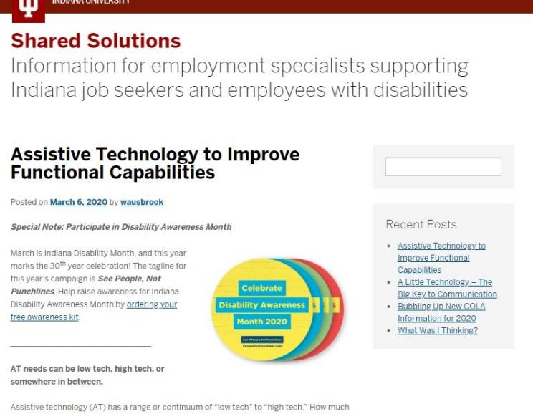
Additional Discovery resources
Visit Shared Solutions, a tips and resource blog from the Employment Technical Assistance team at the Center on Community Living and Careers. The blog will help you gain more information about specific Discovery activities. Review past blog topics listed below.
Informational Interviewing for Discovery
The Meet and Greet
Situational Assessments
Neighborhood Mapping

Slide 26

Job Readiness
3

Slide 27
Job Readiness: Your to-do list
Read the Indiana VR Manual of Employment Services so that you will understand the Job Readiness process and protocols (pages 8-9). Take notes and discuss how to maximize use of Job Readiness with your mentor or supervisor.
Review the Shared Solutions blog post, “Job Ready, Set, Go!”
Job seekers often need additional help to overcome or manage challenges that might be a barrier to employment. Indiana Vocational Rehabilitation has a service option to help work through these challenges.
Job Readiness Training allows you to address a job seeker’s specific needs. Keep in mind that Job Readiness Training must be on the job seeker’s Individual Plan for Employment (IPE) prior to providing support. Discuss the need for Job Readiness Training with the job seeker and VR counselor before including it on the IPE.
Shadow another colleague or your mentor as they develop and write a Job Readiness training plan.
Refer to the Discovery section in the Employment Services Update FAQ, question 9.

Slide 28

Job Development
4

Slide 29
The Job Development & Placement Plan: Your to-do list
Read Part B, the “Job Development and Placement Plan” section in the Hoosier Orientation Handbook on Employment on pages 58-59. Answer question 6 from page 59. Take notes as needed and discuss your response to the question with your mentor or supervisor.
Watch the “how-to” video for the Job Development and Placement Plan form. Take careful notes and bookmark this resource for recurring use and reference.
The Job Development and Placement Plan will state the vocational recommendation, strategies for job development, expectations, roles, and responsibilities. During this process, the job seeker, you, and the VR counselor can assemble a planning team that will create a list of prospective employers and assist with identifying goals.
Read the Indiana VR Manual of Employment Services to better understand the process and protocol for the Job Development and Placement Plan (pages 11, 24, and 30). Take notes and discuss with your mentor or supervisor.
Review questions 1-9 in the “Job Development and Placement Plan Form” section of the Employment Services Update FAQ.

Slide 30

Job Development: Your to-do list
Read the Indiana VR Manual of Employment Services, pages 10-11, to better understand job development with the VR system. Take notes and discuss with your mentor or supervisor.
Complete Resource Ownership, a brief, online course offered free from the Center on Community Living and Careers.
During Job Development, the team will recommend ideal job characteristics, address concerns and barriers to employment, suggest support techniques, and/or commit to providing supports.
Review the Employment Services Activity Guide, Milestone 1 Job Development Phase, found on page 3. (You can download the Guide from the “Employment Services: Information for Providers” page of the Center on Community Living and Careers website.) Talk with your mentor or supervisor about how to use the guide for each person on your caseload.

Slide 31


Job Development: Your to-do list, continued
Watch “Employer Engagement Strategies and Effective Job Development: A Multidementional Approach,” a video from Virginia Commonwealth University’s Rehabilitation Research and Training Center (VCU-RRTC) and from Griffin-Hammis Associates.
Watch “The Pathway from Discovery to Job Development: Essential Steps for Customized Employment Success,” a video from VCU-RRTC and from Griffin-Hammis Associates.
Read the Shared Solutions post, “The Visual Resume: Helping Your Job Seeker Compete.”
Read “Rural Routes: Promising Supported Employment Practices in America’s Frontier,” an article from Cary Griffin, CEO of Griffin-Hammis Associates, Inc.
Visit the Center on Community Living and Career’s Self-Employment information page.
Read “Meaningful Work and Recovery,” on the Mental Health America website.

Slide 32

Job Placement Training & Supports
5

Slide 33
Job Placement Training & Supports :
Your to-do list
Review the Notice of Job Offer (NOJO) form.
Read the Indiana VR Manual of Employment Services to better understand the process and protocol for using the NOJO (pages 4 and 30). Take notes and discuss NOJO with your mentor or supervisor.
Review NOJO information contained within the Employment Services Update FAQ. Be sure that you understand the procedure for submitting a signed NOJO to a VR Counselor.
Once a VR participant has obtained employment in line with their Individualized Plan for Employment goal, you should submit the Notice of Job Offer to VR for approval as soon as possible, preferably at least two business days prior to the job start date.
Review the Milestone Payment Verification form (Note: On the VR web page, it’s listed as “Milestone billing form.”) Study Milestone 1: Job Development and Placement (employed one calendar week). Take notes and discuss Milestone 1 criteria and process with your mentor and supervisor.
Read the Indiana VR Manual of Employment Services to better understand the time period between NOJO and the end of the first week on the job (Milestone 1), pages 10-12. Take notes and discuss Milestone 1 with your mentor or supervisor.

Slide 34

Job Placement Training & Supports:
Your to-do list, continued
Consider registering for the training, Supported Employment: Developing Natural Supports, offered by the Center on Community Living and Careers.
Read the Indiana VR Manual of Employment Services to better understand training and supports (pages 12-17). Take notes and discuss Milestone 2: Support and Short-Term retention (employed four calendar weeks) with your mentor or supervisor.
Read the “Training and Support” section in the Hoosier Orientation Handbook on Employment, pages 66-71. Answer the corresponding questions found on page 71. Take notes as needed and discuss these notes with your mentor or supervisor.
View the five videos about Prompting on the “How-to Video Series” from the Autism Center at Virginia Commonwealth University to better understand evidence-based practices for teaching on the job. (Scroll to the end of the video list. Note that the videos are focused on students in school, but the information can transfer to employment.)

Slide 35

Job Placement Training & Supports:
Your to-do list, continued again
Watch this “Task Analysis” video and listen to the descriptions for both task analysis and the basics of chaining.
Review the Support and Retention Phase, found on page 4 of the Employment Services Activity Guide.
Review the Employment Support and Retention Plan sample with your mentor or supervisor. Take notes for future reference. Rely on other team members for support and guidance.
Watch this how-to video on the Employment Support and Retention Plan. Take careful notes and bookmark this resource for recurring use and reference.
Read the Indiana VR Manual of Employment Services to understand Milestone 2 criteria, paperwork, and protocol (pages 12-17). Take notes as needed and discuss Milestone 2 with your mentor or supervisor.

Slide 36
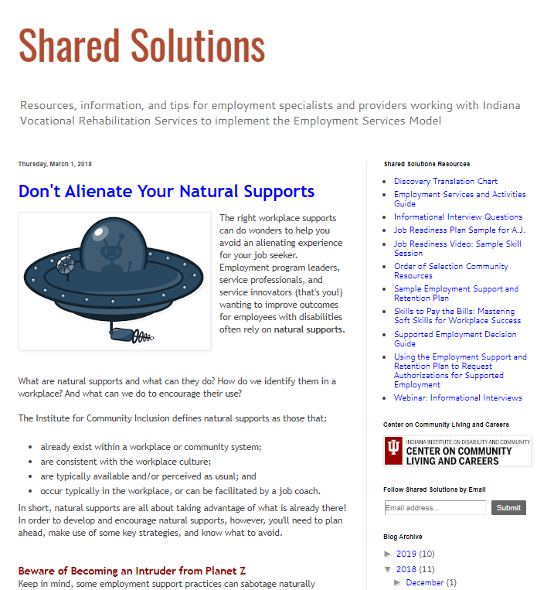
More Resources for Job Placement Training & Supports
Watch T-TAP’s “Fading Job Site Supports” video. Take careful notes and discuss any questions you have with your mentor or supervisor.
Read the Shared Solutions post, “The Fine Art of Fading.”
Read the Shared Solutions post, “Don’t Alienate Your Natural Supports.”

Slide 37

Stabilization
6

Slide 38

Stabilization
Your to-do list
Read the Indiana VR Manual of Employment Services to gain a thorough understanding of stabilization criteria and process. Refer to the manual’s section, “Stabilization,” on pages 13-18.
Watch the how-to video about the Stabilization form and process. Take careful notes and bookmark this resource for recurring use and reference.
Review the VR Stabilization form on the Indiana VR website.
Stabilization is the point at which an individual has reached their greatest level of independence on the job.
After an employee is considered stable on the job for a minimum of 90 days, you can bill for Milestone 3. Remember, if an employee receiving supported employment services isn’t yet stable, you can continue to provide support for up to
24 months.
Read the Shared Solutions blog post, the “Stabilization STAT!”

Slide 39
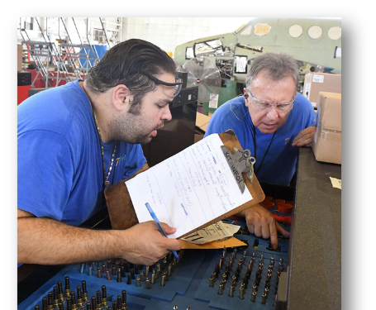
Extended Services & Ongoing Supports
7

Slide 40

Extended Services and Ongoing Supports
Your to-do list
Review the Transfer to Extended Services form on the Indiana VR website.
Learn about and understand Indiana Medicaid Waivers and eligibility .
Learn about and understand the Medicaid Rehabilitation Option.
After Stabilization, you’ll initiate the transfer to extended services and focus on the provision of those services to supported employees.
Funding for those services may include the Medicaid Waiver, the Medicaid Rehabilitation Option, or VR Youth Extended Services. (Note that Milestone 3 does not provide funding for extended services.)
Read the Indiana VR Manual of Employment Services to understand Youth Extended Services (pages 20-21). Learn and understand the transfer process from VR funding to alternate funding.
Read the “Extended Services/Ongoing Supports” section in the Hoosier Orientation Handbook on Employment, pages 72-75. Answer corresponding questions found on page 75. Take notes as needed and discuss them with your mentor or supervisor.

Slide 41
Getting Started:
Training for Indiana
Employment Specialists
*

Slide 42

The importance of additional training
The Getting Started guide is really just that. Talk with your supervisor. He or she will let you know which Indiana employment specialist trainings you should be enrolling in throughout the year.
Explore some of these possibilities for additional learning:
Benefits Information Network (BIN) Certification
Center on Community Living and Careers Employment Trainings
Hands in Autism
PCG Indiana

Slide 43

Become a Certified Employment Support Professional
The National Certified Employment Specialist exam is available every other month in every U.S. state. National certification tells employment providers that you have the knowledge and background you need to help employees and job seekers with disabilities achieve their goals.
Read more about CESP certification and the national exam on the APSE website.

Slide 44

FREE
Indiana Trainings
The Center on Community Living and Careers offers the following free trainings and resources online for Indiana’s employment specialists.
Discovery: Developing Vocational Themes
Discovery in Rural Communities
Effective Conversations
Resource Ownership
Rural Job Development
Self-Employment
Shared Solutions, the blog for Indiana employment professionals

Slide 45
National Training
Griffin-Hammis Associates
Griffin-Hammis Associates is a full-service consulting company, specializing in developing communities of economic cooperation and in creating self-employment opportunities for people with disabilities. Griffin-Hammis serves people with disabilities by providing consultation in community rehabilitation improvement, job creation, and job-site training.
Individual Placement and Support (IPS) Works
Individual Placement and Support (IPS) is a model of supported employment for people with serious mental illness (e.g., schizophrenia spectrum disorder, bipolar, depression).
The LEAD Center
The LEAD Center is a collaborative of disability, workforce, and economic empowerment organizations dedicated to improving employment and economic advancement outcomes for all people with disabilities.

Slide 46
National Training, continued
Marc Gold & Associates
Marc Gold & Associates consists of a network of consultants who provide training and technical assistance to systems, agencies, and families interested in ensuring the complete community participation of people with significant disabilities.
4
5
Virginia Commonwealth University RRTC
Established in 1983, the VCU Rehabilitation Research and Training Center provides resources for professionals, individuals with disabilities, and their representatives.
6
Youth Technical Assistance Center
Y-TAC is a U.S. Department of Education, Rehabilitation Services Administration-funded technical assistance center charged with providing state Vocational Rehabilitation agencies and related rehabilitation and youth service professionals with technical assistance to help more effectively serve students and youth with disabilities.

Slide 47






Produced by:
With funding from:

